Slide 1
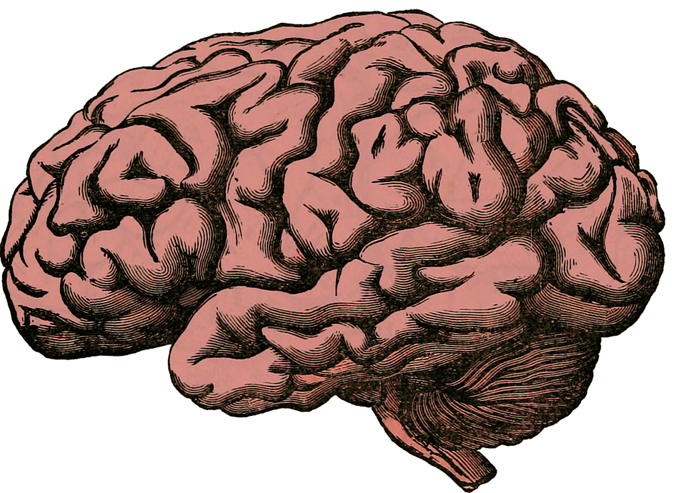
Smart Targets
Specific
Measurable
Achievable
Relevant
Time bound

Slide 2
Smart Targets
Specific
Measurable
Achievable
Relevant
Time bound

Slide 3
Smart Targets
Specific
Should tackle what, who & how.
Exactly what you are going to accomplish.
Who will be involved with your accomplishment.
- How you will achieve your goal.

Slide 4
Smart Targets
I want to be a better at coding.
Specific
Should tackle what, who & how.
Exactly what you are going to accomplish.
Who will be involved with your accomplishment.
- How you will achieve your goal.
I want to become more proficient in front-end web development by completing 6 projects, some of which will be collaborative with Chris

Slide 5
Smart Targets
I want to be a better at coding.
Measurable
Evidence to track your progression.
Progressive overload.
Quantifying your goal.

Slide 6
Smart Targets
I want to be a better at coding.
Measurable
Evidence to track your progression.
Progressive overload.
Quantifying your goal.
I want to become more proficient in front-end web development by completing 6 projects (increasing in difficulty), some of which will be collaborative with Chris. All projects will be uploaded to Git in “Projects_w/Chris” repository.

Slide 7
Smart Targets
I want to be a better at coding.
Achievable
Knowing the bounds.
Being realistic.
Ask a professional.
Challenge yourself!

Slide 8
Smart Targets
I want to be a better at coding.
Relevant
Why have you set this goal?
Where can/will you go after completion?
I want to become more proficient in front-end web development by completing 6 projects (increasing in difficulty), some of which will be collaborative with Chris. All projects will be uploaded to Git in “Projects_w/Chris” repository.

Slide 9
Smart Targets
I want to be a better at coding.
Time Bound
Is this goal achievable within the time constraints set?

Slide 10
I want to be a better at coding.
In hope to move into full-stack web development early 2025, I want to become more proficient in front-end development, before June 2024. I will do this by completing 6 projects (increasing in difficulty), some of which will be collaborative with Chris. All projects will be uploaded to Git in “Projects_w/Chris” repository.

